Slide 1
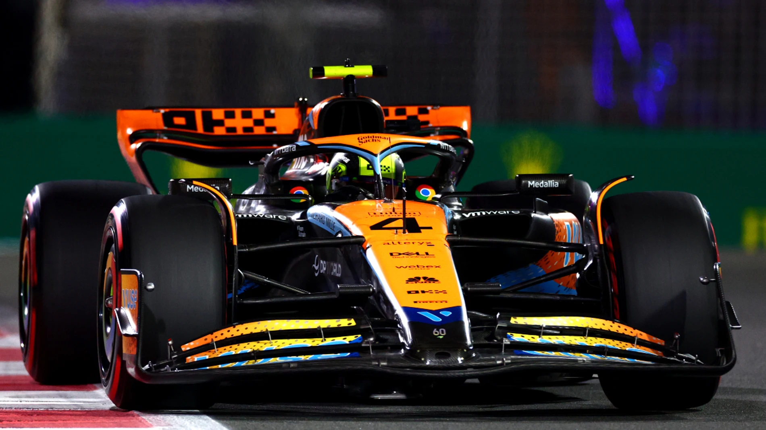



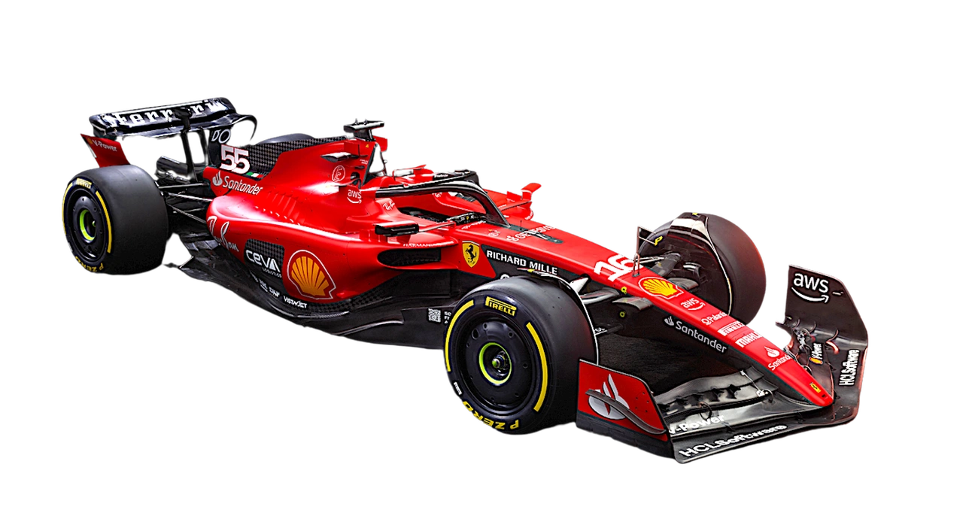
F1LLM
Automotive LLM Model
F1LLM
Davide Benotto – 332150
Manuele Mustari - 319694
Paolo Riotino - 332530

Slide 2

F1LLM
OBJECTIVES
An AI solution for precise POST-SESSION ANALYSIS to enhance racing performance
A Large Language Model (LLM) that efficiently processes telemetry data for RAPID INSIGHTS
TIME-SAVING support for telemetrists with EFFICIENT data analysis

Slide 3

F1LLM
VALUE PROPOSITION
Anticipate the Unseen: DETECT anomalies in order to PREDICT future failures before they become setbacks.
Optimize Potential: SIMULATE, SHAPE, and REFINE the perfect lap by uncovering deeper insights to COMPARE and EVOLVE strategies for continuous improvement.
Our project aligns with SDG 9 by leveraging advanced AI to drive innovation, improve efficiency, and support SUSTAINABLE practices in modernizing motorsport performance and infrastructure.

Slide 4
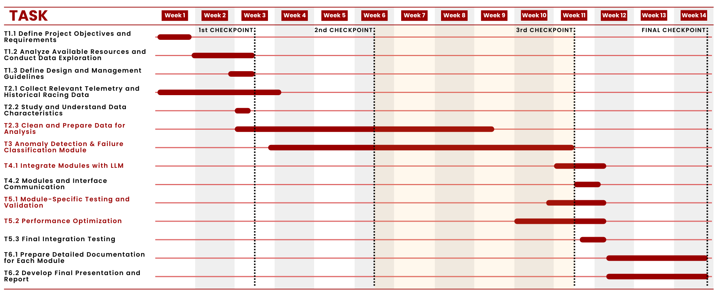
GANTT
F1LLM

Slide 5


F1LLM
DATASET

Slide 6





F1LLM
FASTF1
KEY FEATURES
SESSION DATA
TELEMETRY AND CAR DATA
VISUALIZATION
TRACK & WEATHER CONDITIONS
TABULAR DATA

Slide 7


F1LLM
TARGET AUDIENCE
LLM
Alex
TELEMETRIST
Overwhelmed by data volume, making real-time issue detection difficult.

Slide 8



F1LLM
SOLUTION
SIMPLE to use
USER FRIENDLY
LLM
RAPID results
LLM
Alex
TELEMETRIST
Overwhelmed by data volume, making real-time issue detection difficult.

Slide 9
F1LLM
ANOMALY
DETECTION
&
FAILURE
CLASSIFICATION

Slide 10
ANOMALY DETECTION
DATA PREPROCESSING
F1LLM
TRAIN
TEST
SOURCE
DIFFERENT GRANULARITY → merge (telemetry, weather, laps)
SEASON
From 2019 to 2023
2024
FAILURE FILTER
Data WITHOUT FAILURES
Data WITH FAILURES
DATA CLEANING
Removal of NaN VALUES and DUPLICATE handling
PIT STOP LAPS
Data WITHOUT PIT STOP laps
Complete data WITH PIT STOP laps
NORMALIZATION
DATA TYPE handling to normalize (Min Max Scaler) only NUMERICAL and TEMPORAL values.
MAPPING of CATEGORICAL data
STORAGE
Data are stored in NPZ instead of CSV files in order to reduce the amount of STORAGE ON DISK and OPTIMIZE the data loading and management

Slide 11
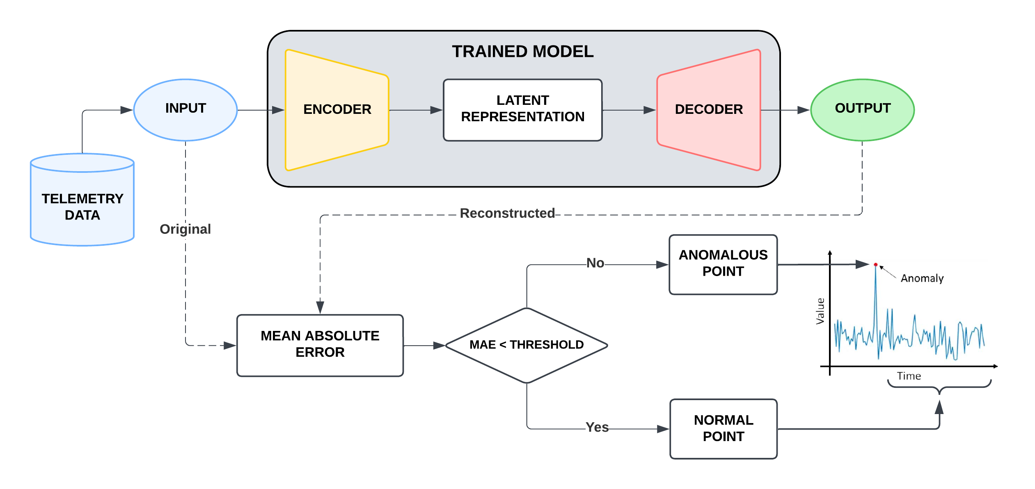
ANOMALY DETECTION
F1LLM
AUTOENCODER

Slide 12
ANOMALY DETECTION
F1LLM
TRAINING
SLIDING WINDOWS and different BATCH SIZE to reduce the load on RAM.
KFOLD CROSS VALIDATION to generalize the model and reduce the overfitting.
Different LEARNING RATE and OPTIMIZER to improve the model.
LOW final LOSS value reached

Slide 13
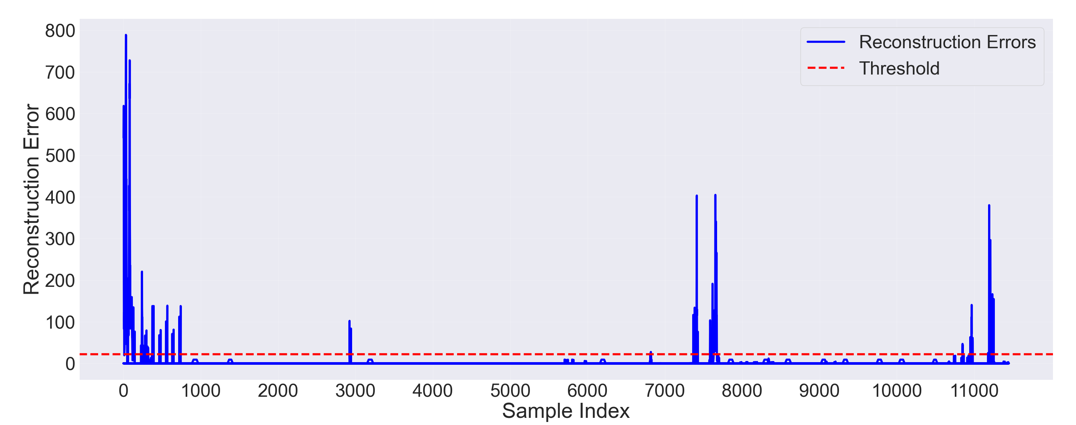
ANOMALY DETECTION
F1LLM
RESULTS
The model find TELEMETRY IRREGULARITIES on new unknown data complete of failures
The user analyze the output anomalies and give the anomaly span to the classifier

Slide 14
ANOMALY DETECTION
F1LLM
RESULTS
The model find TELEMETRY IRREGULARITIES on new unknown data complete of failures
The user analyze the output anomalies and give the anomaly span to the classifier
START LAPS
PIT STOP
FAILURES

Slide 15
FAILURE CLASSIFICATION
DATA PREPROCESSING
F1LLM
Propose a FAILURE CATEGORY that can be identified and CLASSIFIED based on the anomalies DETECTED in the data
45
different anomalies
8
failure groups

Slide 16


FAILURE CLASSIFICATION
F1LLM
TRAINING
RANDOM FOREST
NEURAL NETWORK

Slide 17
FAILURE CLASSIFICATION
F1LLM
TRAINING
RANDOM FOREST
NEURAL NETWORK
PROS:
Powerful for COMPLEX PATTERNS
Adaptable to HIGH-DIMENSIONAL data
Considers feature INTERACTIONS
CONS:
Computationally EXPENSIVE
LESS INTERPRETABLE
DIFFICULT to tune

Slide 18
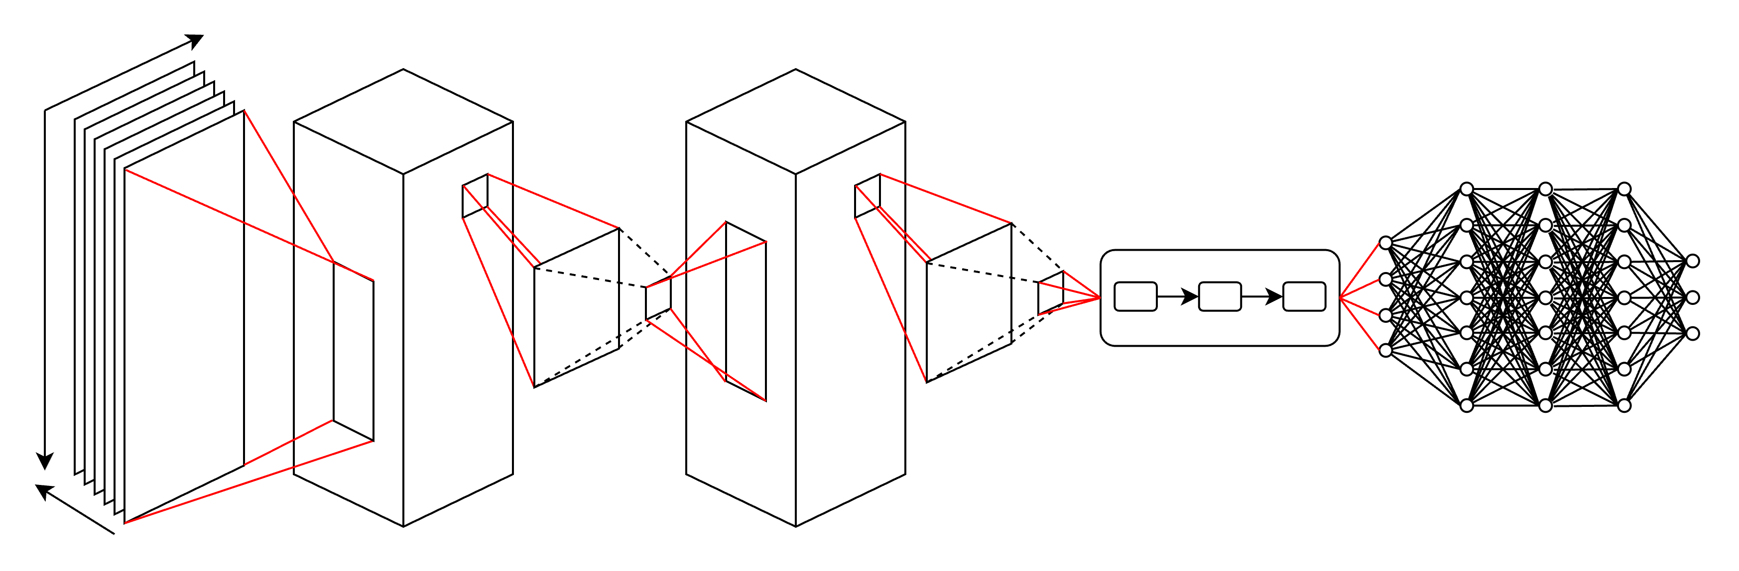
FAILURE CLASSIFICATION
F1LLM
CNN + LSTM + FC
INPUT
CONVOLUTIONAL + POOLING
Features
FULLY CONNECTED
LSTM
OUTPUT
Sequences
Batches

Slide 19

FAILURE CLASSIFICATION
F1LLM
RESULTS
CANADIAN GRAND PRIX
Actual Anomaly
Engine
Predicted Anomaly
Engine
HUNGARIAN GRAND PRIX
Actual Anomaly
Suspension and Drive
Predicted Anomaly
Suspension and Drive
MEXICOCITY GRAND PRIX
Actual Anomaly
Braking System
Predicted Anomaly
Transmission and Gearbox

Slide 20

F1LLM
FUTURE WORKS
LAP SIMULATION
1
TELEMETRY COMPARISON
2

Slide 21
F1LLM
FUTURE WORKS
LAP SIMULATION
1
Analyzing historical qualifying data to predict CAR PERFORMANCE
TELEMETRY COMPARISON
2
Evaluation through TEAMMATE PERFORMANCE analysis
Comparison with FASTER DRIVERS

Slide 22
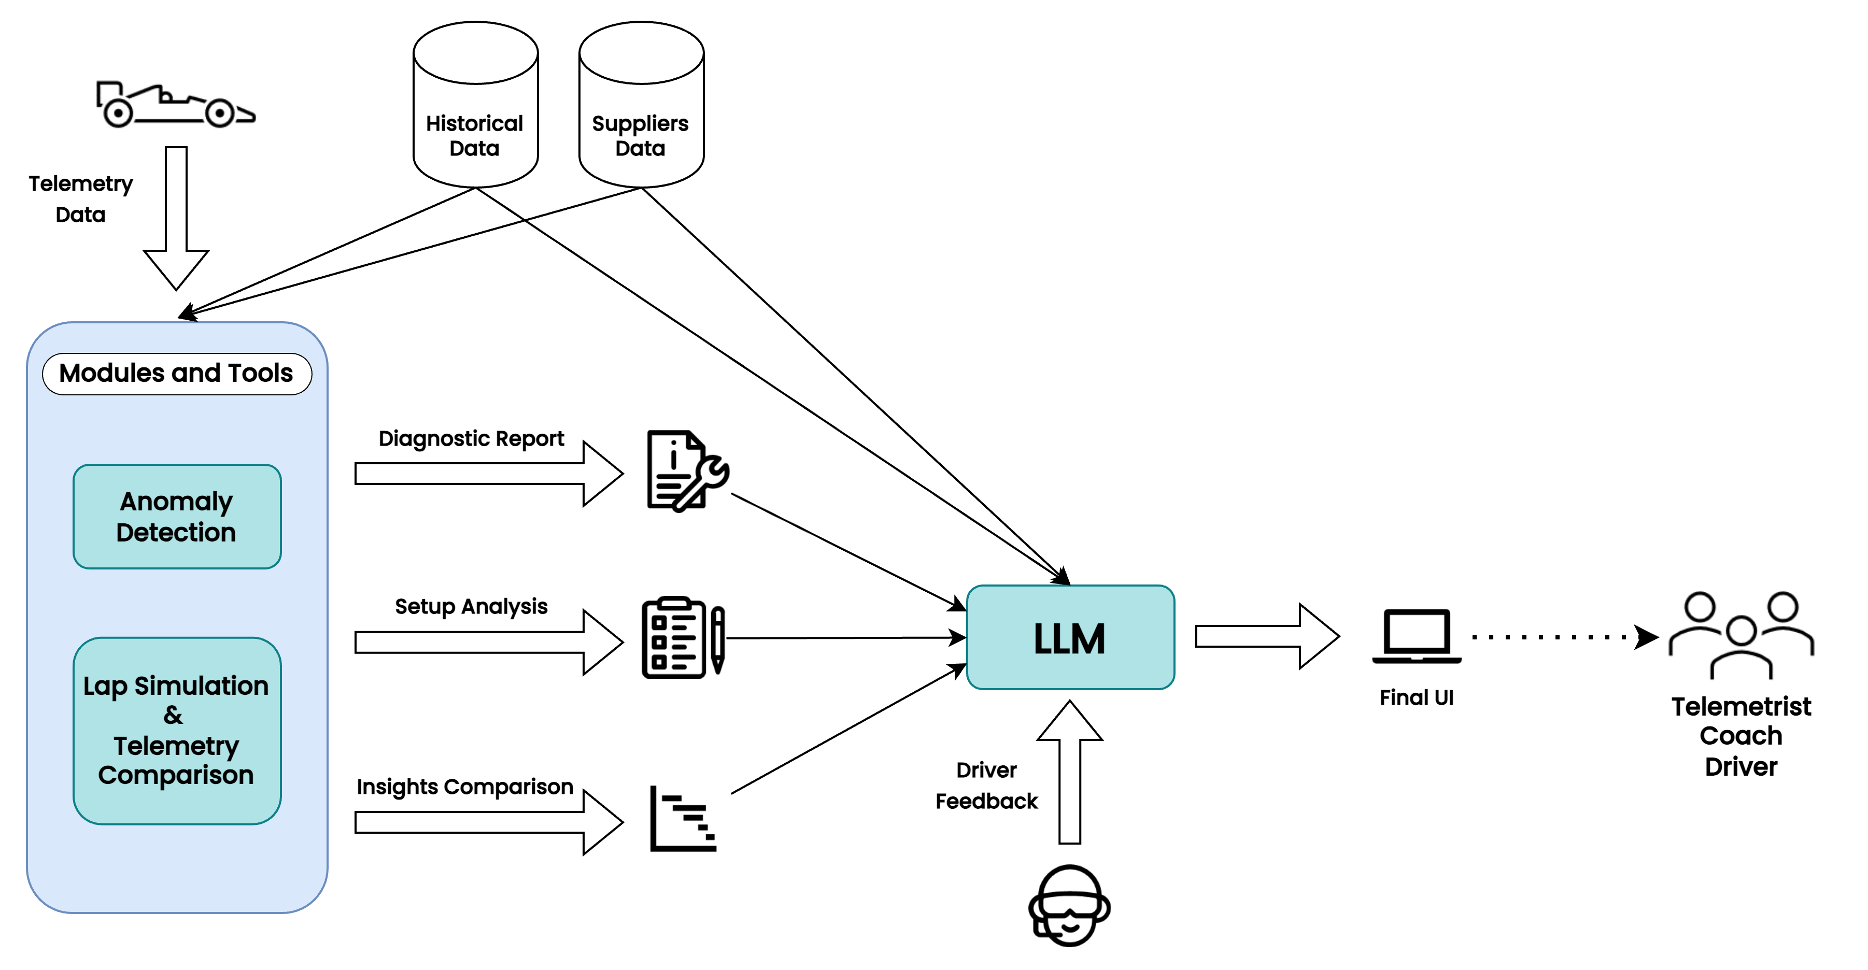
F1LLM
FUNCTIONAL DIAGRAM

Slide 23
THANK YOU
FOR YOUR ATTENTION
F1LLM

